Slide 1


Tales from the Azure Migration Trenches
Jimmy Bogard
@jbogard
github.com/jbogard
jimmybogard.com
Notes:
“Happy families are all alike; every unhappy family is unhappy in its own way.” – Tolstoy, Anna Karenina, 1878

Slide 2
“Greenfield cloud apps are all alike; every cloud migration is hard in its own way”
- Me, just now

Slide 3

Migration Strategy

Slide 4

Phase 1: Assess

Slide 5
Phase 1: Assess
Server Infrastructure
Application Hosts (Compute)
Storage (Databases, files, etc.)
Environments
Network Infrastructure
VLANs, VPNs, DNS, TLAs
Software Development Lifecycle
Tools used
Processes and gates

Slide 6
Application Survey
2 web applications
“Internal” Admin app
“External” Public app
ASP.NET 4.8 (also migrating to .NET 6)
Various middleware (Hangfire, SignalR, etc)
2 application databases
Internal app communicates to both
External app communicates to one
SQL Server Agent used for some jobs

Slide 7
Application Survey
3 deployed environments
QA, Stage, Prod
Stage gates Prod
Incoming and outgoing integrations
Incoming web hooks
Various outgoing API calls
Varying security measures

Slide 8

Production Server Infrastructure
Load Balancer
ProdAppServer1
ProdDBServer
IIS
admin
public
Admin
Public
ProdFileServer
ProdAppServer2
Same as above

Slide 9
QA/Stage Server Infrastructure
Load Balancer
QAAppServer1
QADBServer
IIS
QA
Stage
QA
Admin
admin
public
admin
public
Public
Stage
Admin
Public
QAFileServer
QA
Stage
QAAppServer2
Same as above

Slide 10
Networking Infrastructure
More Stuff
Stuff
Our Junk
Even More Stuff

Slide 11
SDLC (All on-prem)
Source Control
Bitbucket
Issues/stories
JIRA
Build
Psake
CI
TeamCity calling Psake
CD
TeamCity calling Pstrami

Slide 12
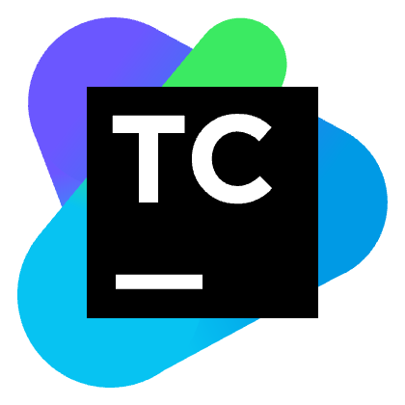

SDLC
Repo
CI
Deploy
Source Code
Build
Release

Slide 13

Phase 2: Design

Slide 14
Guiding Principles
Platform-as-a-Service preferred
Infrastructure-as-a-Service if forced
Avoid “re-architecting”
AKA a “PaaS-ified Lift and Shift”

Slide 15





SDLC Tooling
Psake
Build and Deploy

Slide 16




Compute Resources

Slide 17
Database Resources
Azure SQL Managed Instance
SQL Server on Azure VMs
Azure SQL Database
PaaS
IaaS

Slide 18
Azure SQL Migration Options
Technology | Description
Azure Migrate | Assessment tool
Azure SQL Migration extension for Azure Data Studio | Uses Azure Database Migration Service to assess and migrate
Transactional replication | Pub-sub model to enable transactional consistency
BACPAC | Database schema and data exported to a file and imported via the Azure portal
Bulk copy | Uses the bcp command line tool or library to bulk import data
Azure Data Factory | SSIS in the cloud, hosted ETL
SQL Data Sync | Client/server bidirectional syncing for Azure SQL and SQL Server

Slide 19
Azure SQL Migration
Technology | Online/offline?
Azure SQL Migration extension for Azure Data Studio | Offline
Transactional replication | Online
BACPAC | Offline
Bulk copy | Offline
Azure Data Factory | Online
SQL Data Sync | Online

Slide 20
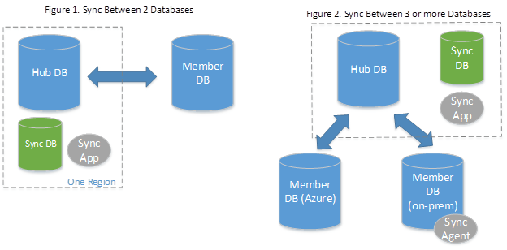
SQL Data Sync

Slide 21
General Limitations
Each table must have a primary key
Snapshot isolation must be enabled
PK values can’t be weird
Schema/table/column names can’t be weird
Table names must be unique
User-defined types aren’t supported
Truncated tables won’t sync
Schema changes aren’t automatically replicated

Slide 22
Unsupported data types
FileStream
SQL/CLR UDT
XMLSchemaCollection (XML supported)
Cursor, RowVersion, Timestamp, Hierarchyid
Computed columns
Read-only columns

Slide 23
Limitations on service/DB dimensions
Dimensions | Limit | Workaround
Maximum number of sync groups any database can belong to. | 5
Maximum number of endpoints in a single sync group | 30
Maximum number of on-premises endpoints in a single sync group. | 5 | Create multiple sync groups
Database, table, schema, and column names | 50 characters per name
Tables in a sync group | 500 | Create multiple sync groups
Columns in a table in a sync group | 1000
Data row size on a table | 24 Mb

Slide 24
Database Migration Challenges
One database somewhat large (150 GB)
Used as file storage
Schema includes varbinary(max)
Individual rows in 100s of MB
It broke every Azure migration service
Solution: SqlPackage.exe on bare metal

Slide 25
Export/Import VM Constraints
Enough disk space to process the import and export (roughly 3x the DB size, ~500GB)
Enough RAM to process the individual rows in memory (16GB was the minimum successful import, last import was 64GB)
Sufficient bandwidth and I/O performance to migrate in a reasonable amount of downtime, 8 hours or less

Slide 26
Black Sheep DB Migration Process
Begin application downtime
Remove Windows users from the on-prem database
Export on-prem database to a BACPAC file (using SqlPackage.exe from on-prem server)
Bump Azure SQL SKU to Ludicrous Edition
Turn off Private Links etc.
Import BACPAC file to Azure (using SqlPackage.exe from on-prem server)
Bump Azure SQL SKU to Normal and turn on Private Links etc.

Slide 27
Migration Process
Correct schema
Initialize schema
Sync data

Slide 28
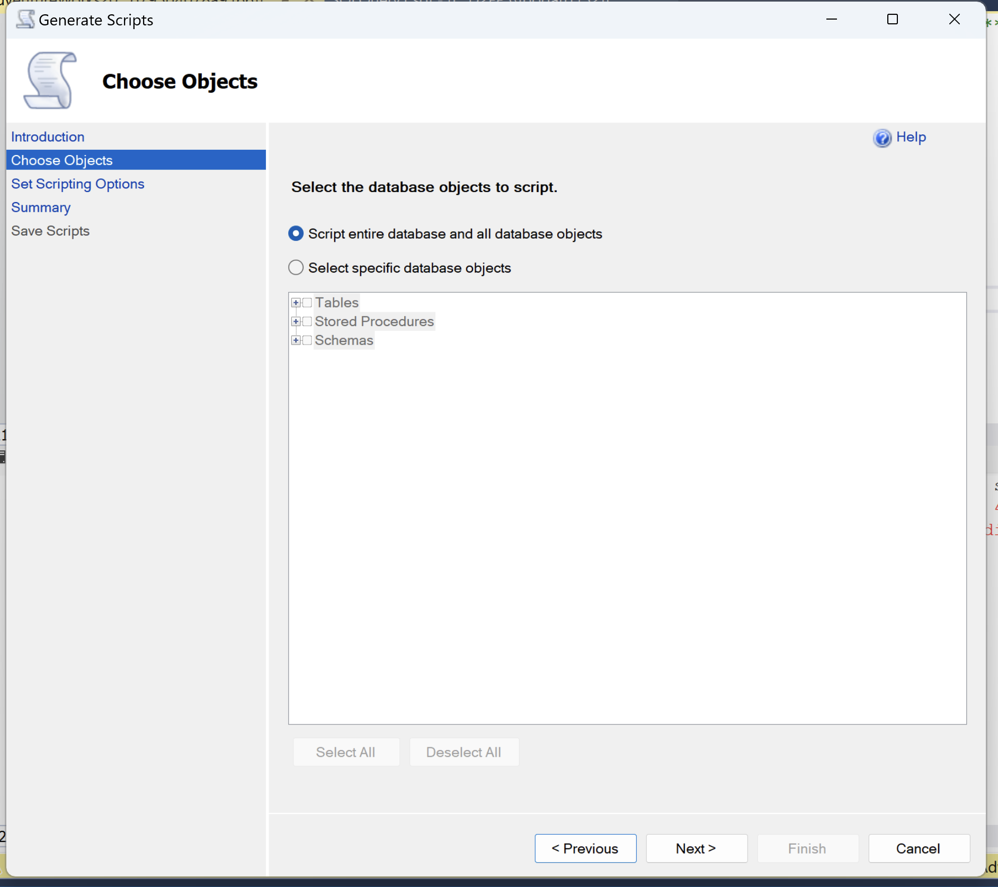
Initialize Schema
Can use SSMS
Some auto-generated tables can be skipped
Include indexes, triggers, etc.

Slide 29
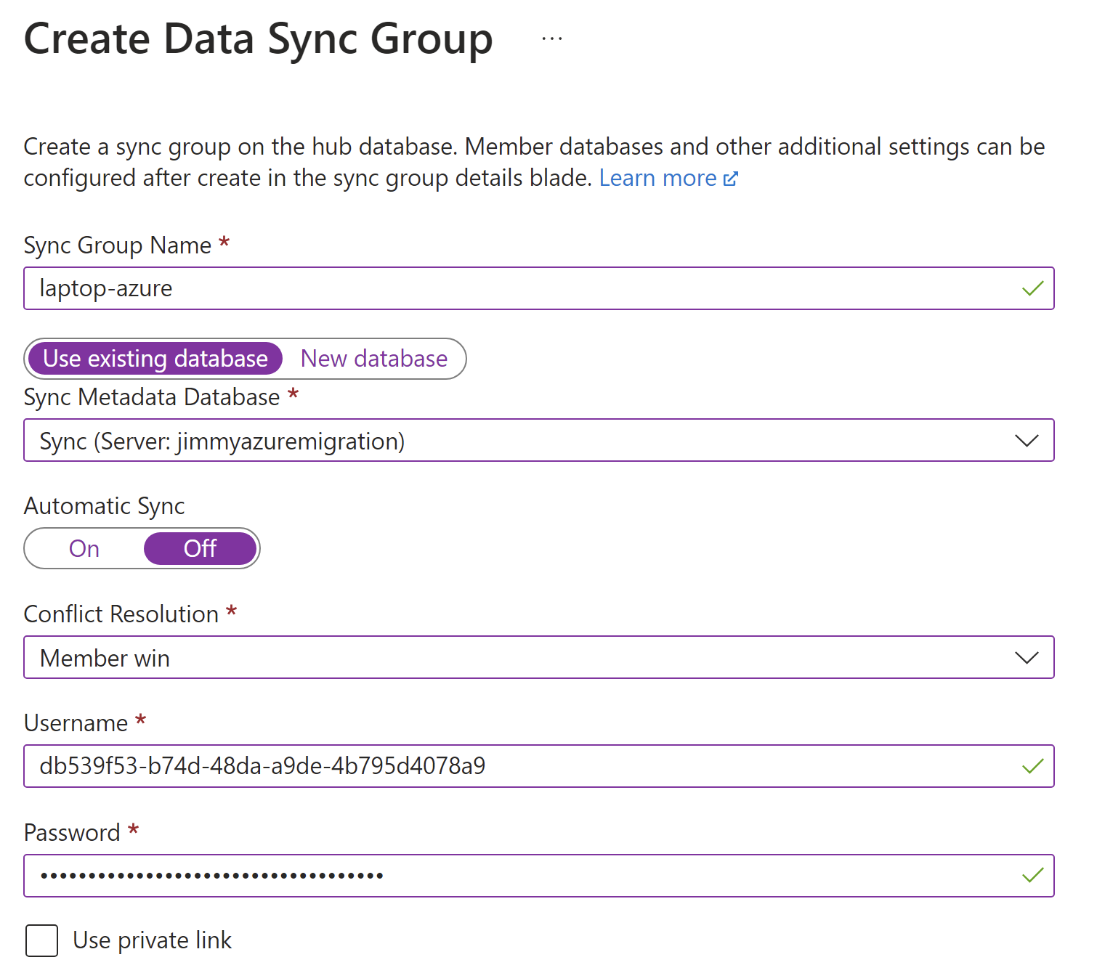
Create Sync Group

Slide 30
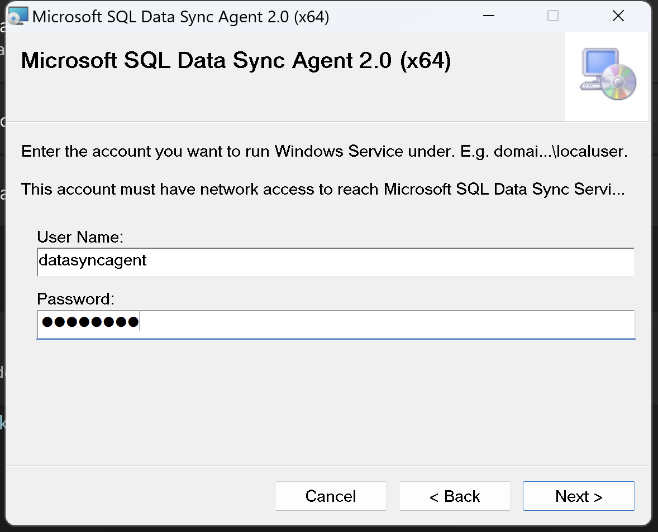
Local Sync Agent

Slide 31
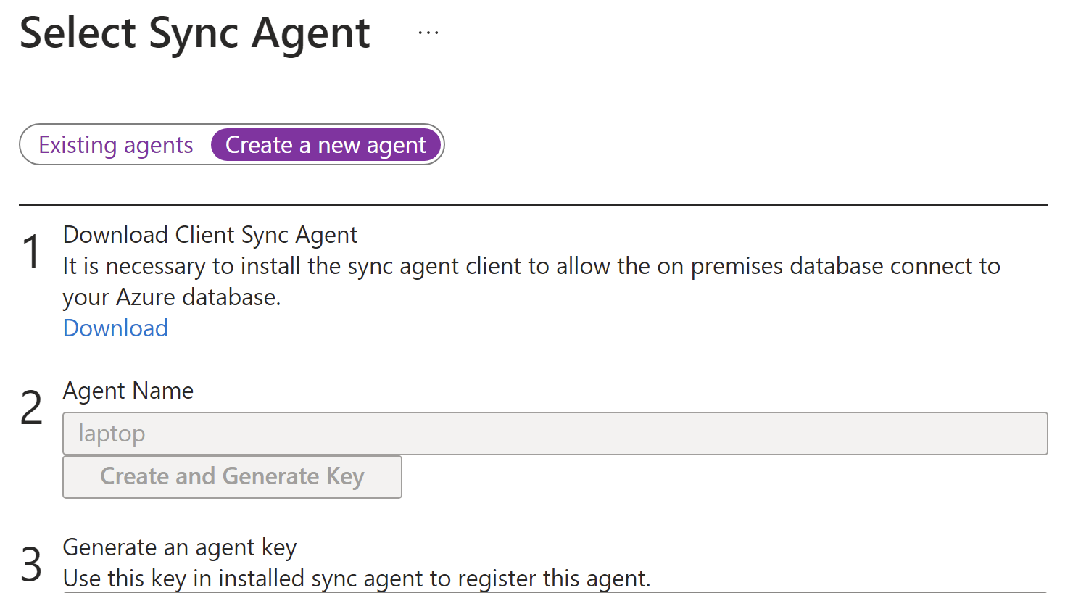
Local Sync Agent

Slide 32
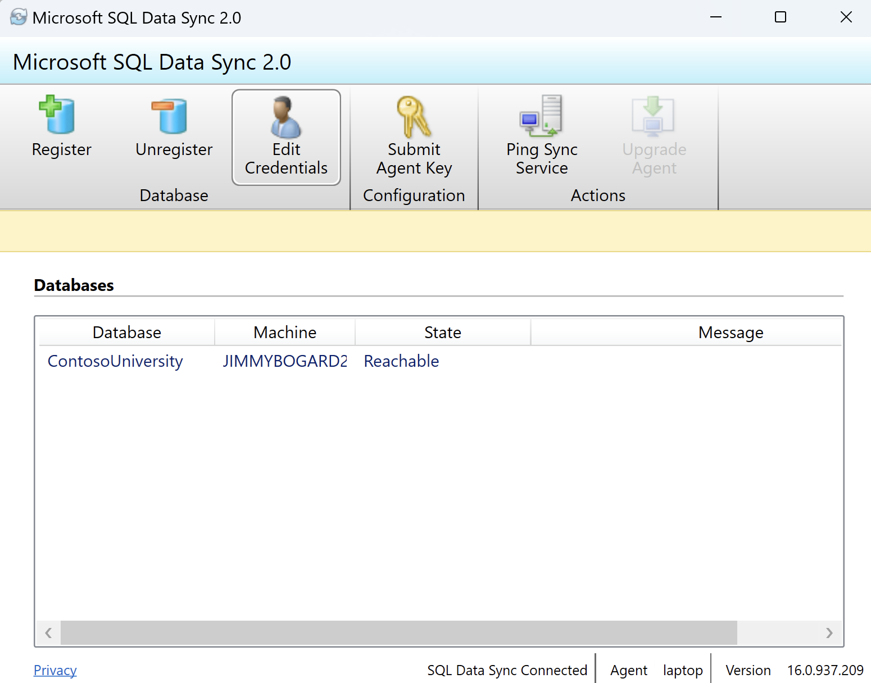
Local Sync Agent

Slide 33
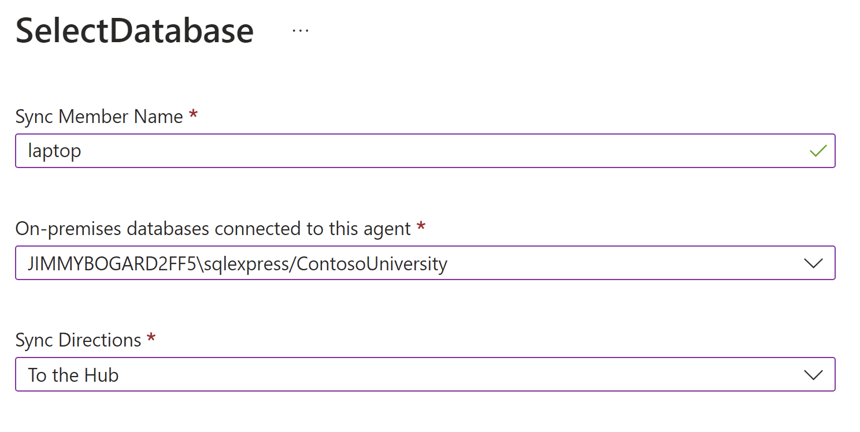
Configuring On-Prem DB

Slide 34
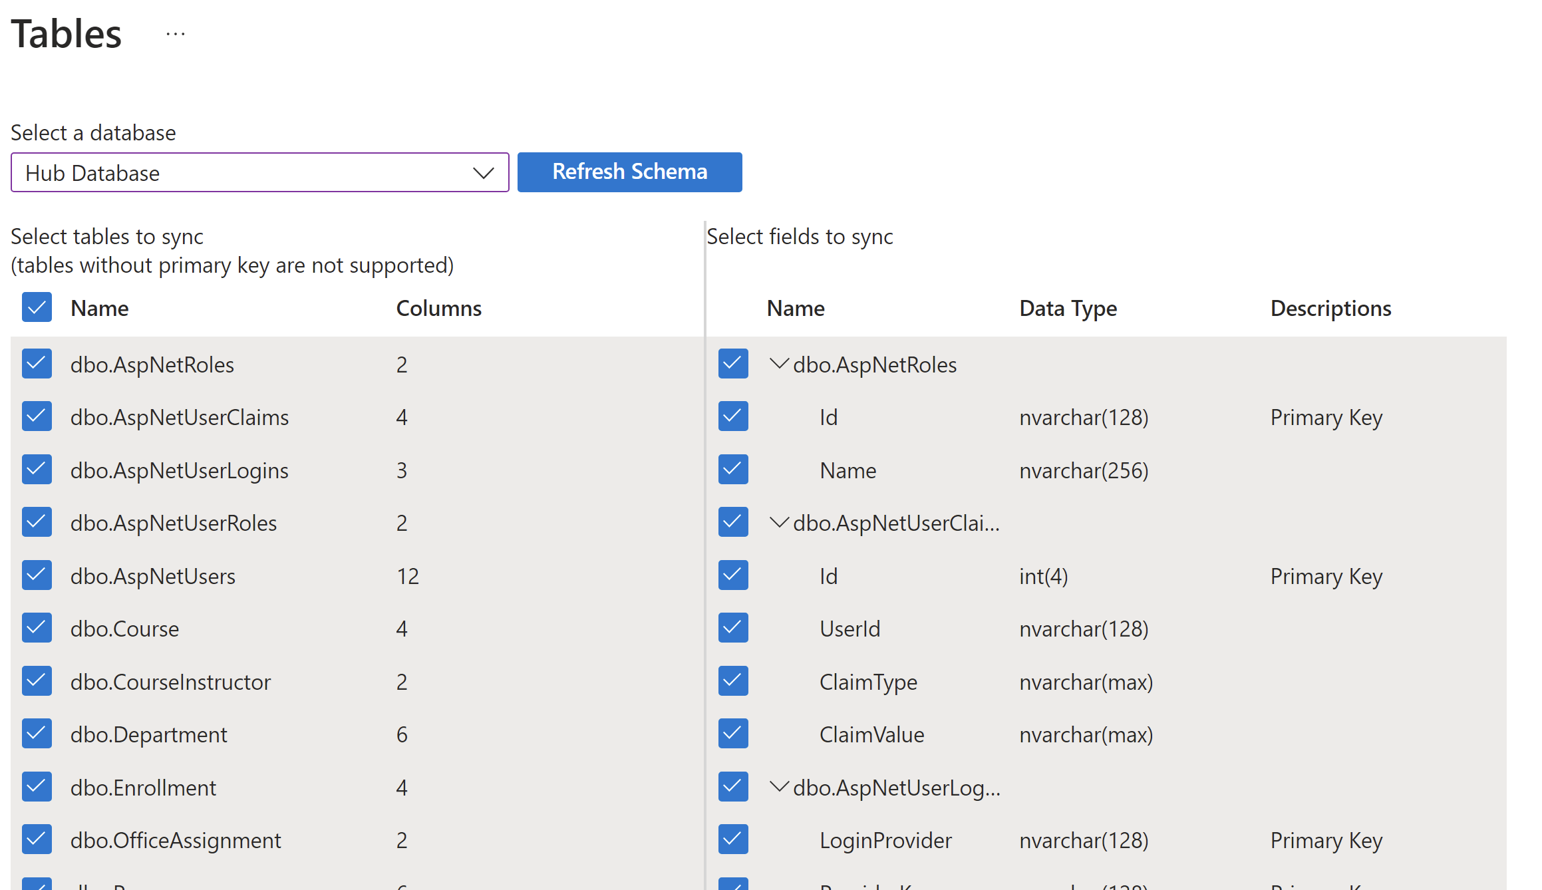
Table Configuration

Slide 35
SQL Data Sync - Demo

Slide 36
Schema Update Process
Pause Sync
Deploy Schema Changes
Reconfigure Tables and Columns
Re-enable and Run Sync

Slide 37
Files Migration
Use robocopy, preferably with a Jobs file
Tune threads for performance (/MT:20)
Mirror (/MIR) to preserve structure
Scheduled task to automate

Slide 38

Azure App Service Migration
Prod
Azure DevOps Pipelines manage deployment into Azure
TeamCity continues to manage deployments into on-prem
Release strategies preserved
Each build and release pipeline independent of each other
Application configuration duplicated per pipeline
Release
Build
Repo

Slide 39
App Configuration Migration
Non-secrets in config transforms
Web.Dev.config
Web.Test.config
Web.Prod.config
Secrets in ADO Pipeline variables
Use Config transforms to “poke” XML
Correct config names/locations to conform to ADO pipeline limitations
Manually sync between pipelines

Slide 40
SignalR Migration
Current app used ASP.NET SignalR
ASP.NET SignalR does NOT support Azure SQL because…reasons
Azure SignalR is ASP.NET Core SignalR
Feature flags to toggle
Shims to swap hubs/clients

Slide 41
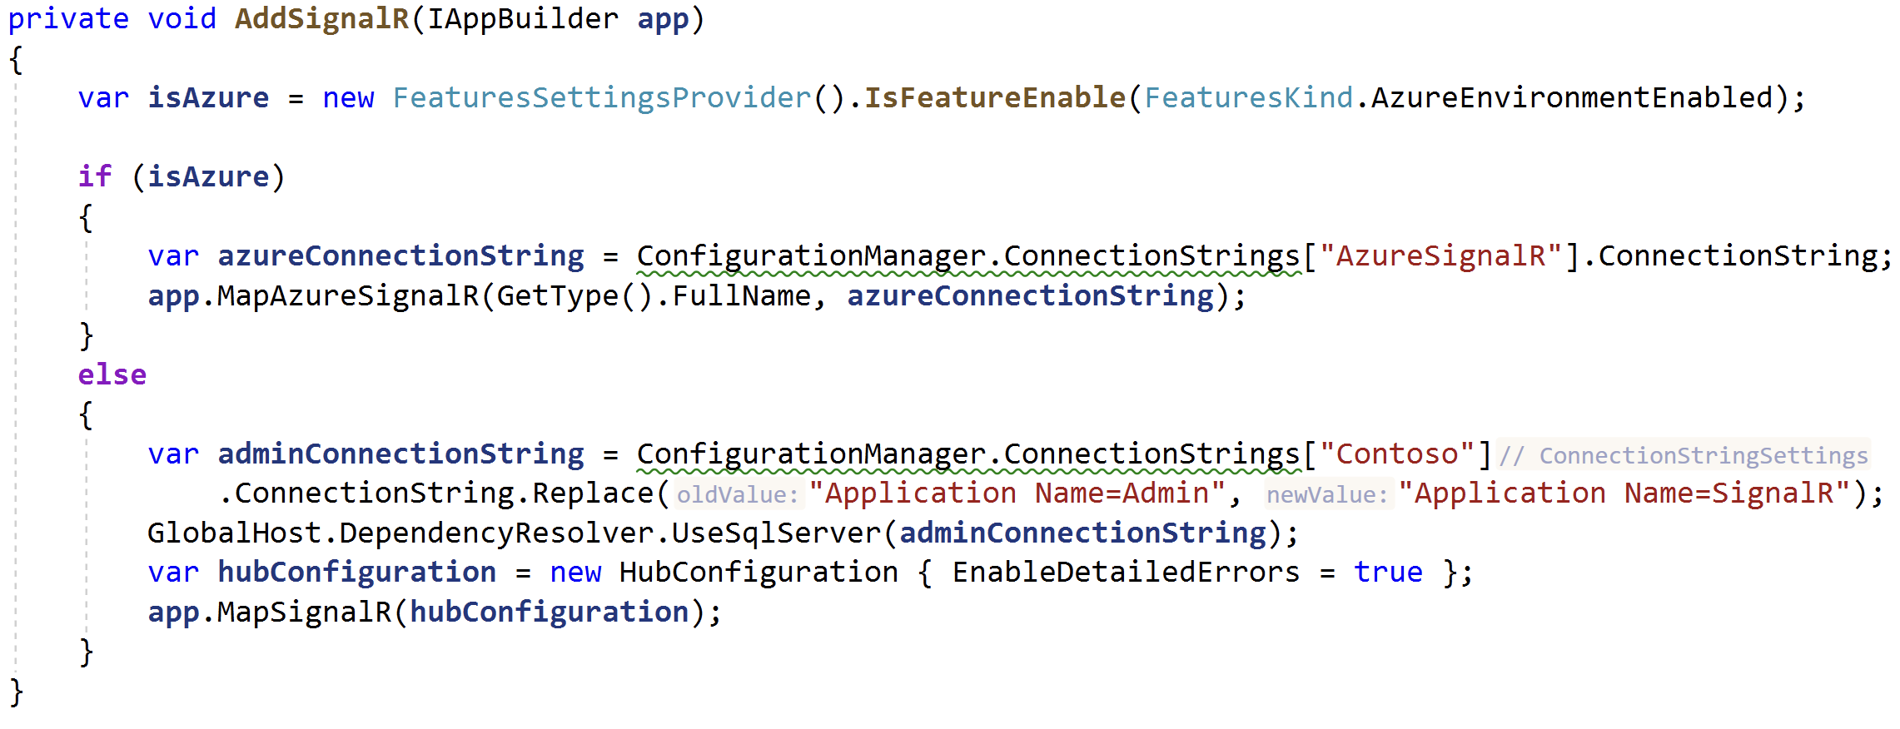
SignalR Feature Toggle

Slide 42
Azure Networking Infrastructure
More Azure Stuff
Azure Stuff
Our Azure Junk
Even More Azure Stuff

Slide 43

Azure Automation
More Azure Stuff
Our Azure Junk
Azure Stuff
Even More Azure Stuff

Slide 44
Prototyping
All potential technologies prototyped before final decision
All architectural decisions logged in an Architecture Decision Record
Used a “Sandbox” environment/subscription as a playground

Slide 45
Environment Release Timeline
3 weeks before
Azure environment complete
2 weeks before
Release pipeline finished
Data sync set up and kicked off
File sync set up and kicked off
1 week before
Data validation
Environment validation
Configuration validation

Slide 46
Phase 3: Go-live(s)

Slide 47
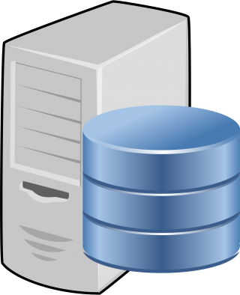





Environment Cutover
Storage
Sync
Enable Maintenance Mode (on-prem)
Disable Hangfire (on-prem)
Run DB Migration
Run File Sync
Flip DNS
Enable Hangfire (Azure)
Disable maintenance mode (CloudFlare)
Smoke test/monitor
🍾🥂🥳
Compute
DNS

Slide 48
Environment Rollout
QA
Stage
QA includes full regression testing
Fast-follow on Prod to prevent bottlenecks
Prod

Slide 49
Lessons Learned
Prototype technologies before choosing
Don’t let perfect be the enemy of good
Resist “fixing” architecture
Be careful with infrastructure changes during rollout
If you’ve prepared, roll out should be boring

Slide 50

Tales from the Azure Migration Trenches
DDD with Vertical Slice Architecture Training
July 17-18th in Rotterdam
20% discount code Techorama20

